Slide 1
CAR Calibration Meeting CAR Review
AP Team
Funny Li, Tony Hsu and Ronald Tse
September 2013

Slide 2
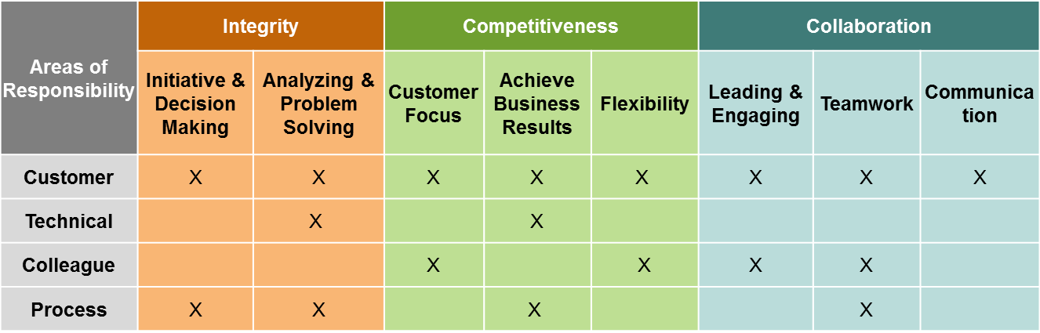
CAR Champion Critical Behaviors for Success
Alignment with Critical Behaviors for Success and UL Values
CAR Champion, Areas of Responsibility:
C – Customer; T – Technical; L – Colleague; P – Process.
Notes:
EIGHT (8) CBS attributes :-
(CAR Champion, Areas of Responsibility: C – Customer; T – Technical; L – Colleague; P – Process)

Slide 3
Study for CAR# 123911678

Slide 4
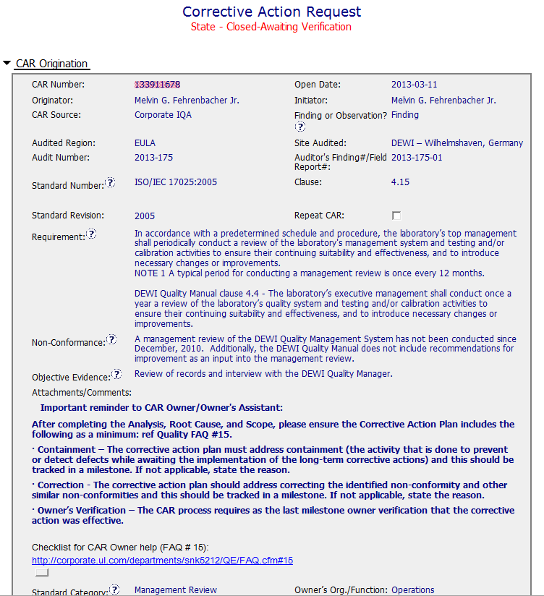
CAR# 133911678
There are TWO (2) discrepancies: a) Failure conducting Management Review in the required time period, and b) Missing input element in the Management Review process. There should be two separate root cause analysis.
Moderate Instruction Provided
Notes:
For the CAR# 133911678:
[CAR Review based on 00-QA-S0006 - Corrective Action Request Process]
In the session of “Non-Conformance”, there are TWO (2) discrepancies:
Failure conducting Management Review in the required time period, and
Missing input element in the Management Review process. There should be two separate root cause analysis.

Slide 5
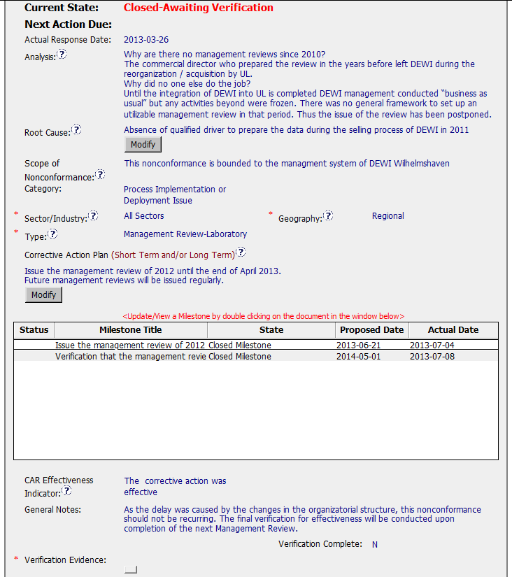
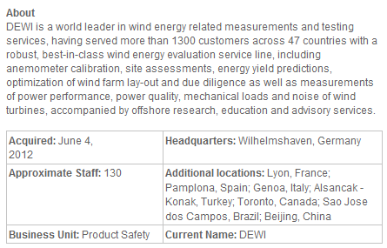
CAR# 133911678 (Analysis)
The “5 WHYs” approach hasn’t been utilized well because it doesn’t seem that it is able to identify the possible causes.
And there is no analysis related to illustrate why “Recommendation for improvement” is not covered as input in the process of Management Review stated in the current DEWI Quality Manual.
DEWI is merged on 2012-06-04, how about year 2011?
No linkage from Analysis to Root Cause “qualified driver”??
[Collaboration] (C L) – To be improved by engaging with CAR Owner to get deeper analysis.
[Competitiveness] (C) – To be improved by engaging with CAR Owner to get a clear path of analysis.
[Integrity] (P) – To be improved of determination by declining the insufficient analysis results.
Notes:
Analysis – clear path to root cause; stakeholders identified
There are TWO (2) discrepancies: a) Failure conducting Management Review in the required time period, and b) Missing input element in the Management Review process. There should be two separate root cause analysis.
The “5 WHYs” approach hasn’t been utilized well because it doesn’t seem that it is able to identify the possible causes. For example, as mentioned in the “Analysis” field that “There was no general framework to set up an utilizable management review in that period. Thus the issue of the review has been postponed….” It is questionable whether it is specifically illustrated in the DEWI Quality Manual about the process and framework of Management Review, or the process is not even existing, or other reasons resulting now Management Review is not executed in the required timeframe after a personnel left the organization? The “5 WHYs” analysis can go further deeper.
In addition, does a statement “… Thus the issue of the review has been postponed.” mean that does the previous Management Review officially determine to be postponed? If yes, is there any supporting evidence?
And there is no analysis related to illustrate why “Recommendation for improvement” is not covered as input in the process of Management Review stated in the current DEWI Quality Manual.

Slide 6
CAR# 133911678 (Root Cause & Scope)
Not quite sure whether how would the process and initiator of the Management Review be outlined in the Quality Manual or the related SOPs. For the instance, is there a deputy person being determined to keep running of the Management Review process for any reason the initiator is absence.
Another root cause is not addressed and identified.
The widespread of the discrepancy has not been addressed in this field. e.g. How would it be affected by division, operation team, function, area/region, and the time period?
[Collaboration] (C L) – To be improved by engaging with CAR Owner to get succinct and reasonable root cause statement.
[Competitiveness] (C) – To be improved by engaging with CAR Owner to get succinct and reasonable root cause statement.
[Integrity] (P) – To be improved of determination by declining the incomplete root cause.
Notes:
Root Cause – is succinct; reasonable and complete based upon the analysis
Not quite sure whether how would the process and initiator of the Management Review be outlined in the Quality Manual or the related SOPs. For the instance, is there a deputy person being determined to keep running of the Management Review process for any reason the initiator is absence.
Absence of the initiator in this case is not necessary resulting the failure of the quality process. [Refer to back to the result of the root cause analysis]
As mentioned above, there should be two separate root cause analysis. Another root cause is not addressed and identified.
Scope – tells how widespread the problem is
The widespread of the discrepancy has not been addressed in this field. e.g. How would it be affected by division, operation team, function, area/region, and the time period?
Remarks: Prior to the CAR review, if I were the CAR Administrator, it is necessary to clarify what are the differences to the organizations of DEWI and DEWI Wilhelmshaven, are they different entities? And is there any operation connection to DEWI-OCC?

Slide 7
CAR# 133911678 (Category, Sector/Industry, Type & Geography)
Satisfaction
Satisfaction
Not clearly illustrated in the field of “Analysis” to support it to be identified as “Regional”.
Satisfaction
[Collaboration] (C L) – To be improved by engaging with CAR Owner to clarify the rationale of geography selection.
[Integrity] (T) – Good. Appropriate “Category”, “Sector/Industry” and “type” are selected.
Notes:
Category
→ Satisfaction
Sector/Industry
→ Satisfaction
Type
→ Satisfaction
Geography – apparent from the analysis
Not clearly illustrated in the field of “Analysis” to support it to be “Regional”.

Slide 8
CAR# 133911678 (Corrective Action)
If it only addresses the Containment to the “Root Cause” recorded above, it is sufficient…
However, the reason of why failure conducting of previous Management Review is not addressed in the fields of “Root Cause” and “Correction Action Plan”.
The corrective action managing the root cause has not been addressed.
Again, there is no any corrective action related to address why “Recommendation for improvement” is not covered as input in the process of Management Review stated in the current DEWI Quality Manual.
[Collaboration] (C L) – To be improved by working with CAR Owner to get the reasonable CA Plan that is able to fix the root cause.
[Competitiveness] (C) – To be improved by engaging with CAR Owner to fix the objective evidence and other problems found.
[Integrity] (P) – To be improved of determination by declining the insufficient CA Plan.
Notes:
Corrective Actions – fix the objective evidence
If it only addresses the Containment to the “Root Cause” recorded above, I think it is sufficient…
However, the reason of why failure conducting of previous Management Review is not addressed in the fields of “Root Cause” and “Correction Action Plan”.
Corrective Actions – address the entire root cause
As noted above, it is sufficient to cover the containment action though, the corrective action managing the root cause has not been addressed.
Again, there is no any corrective action related to address why “Recommendation for improvement” is not covered as input in the process of Management Review stated in the current DEWI Quality Manual.
Corrective Actions – address the items identified in the analysis
As noted above.
Corrective Actions – cover the scope and geography
Comment as stated in “Geography” above.

Slide 9
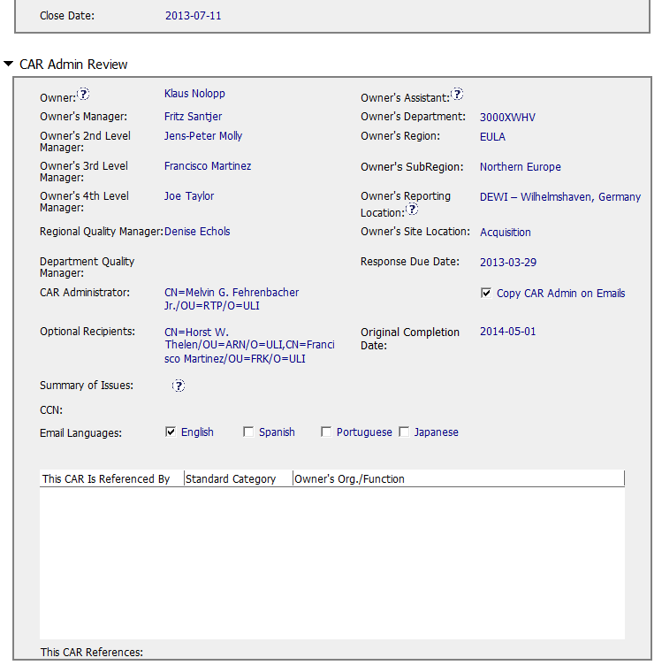
CAR# 133911678 (CAR Admin Review)
Good and No Abnormality
[Collaboration] (C L) – Good. CAR Owner, CAR Escalation Path and Optional Recipients are set appropriately.
Notes:
Good and no abnormality is found.

Slide 10
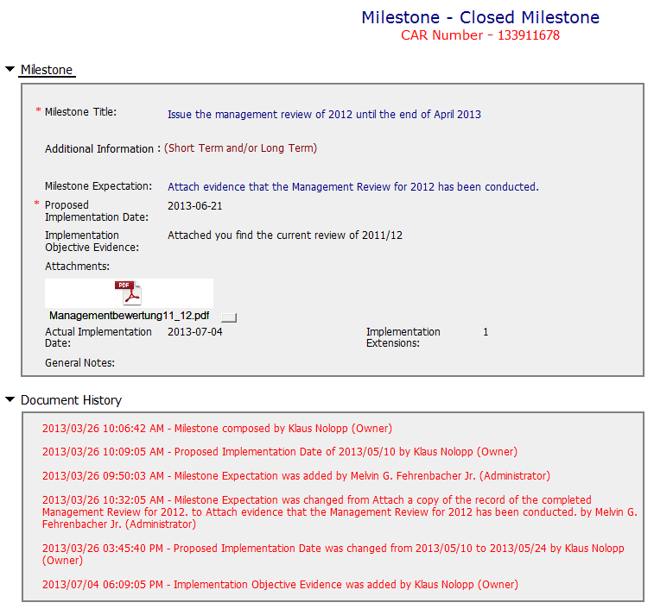
CAR# 133911678 (Milestones)
Milestone solely for containment is good (i.e. Management Review Report for Year 2011 and Year 2012).
[Suggest to inviting a person could read German for verification whether “Recommendation for improvement” is now covered as input in the process of Management Review.]
[Collaboration] (L, C L) – Good. Containment and its supporting evidence are reviewed appropriately.
Notes:
Milestones – address containment unless CAP indicates reason why not required
Milestone solely for containment is good but not for corrective action. [Suggest to inviting a person could read German for verification whether “Recommendation for improvement” is now covered as input in the process of Management Review.]
See below comments for corrective actions.

Slide 11
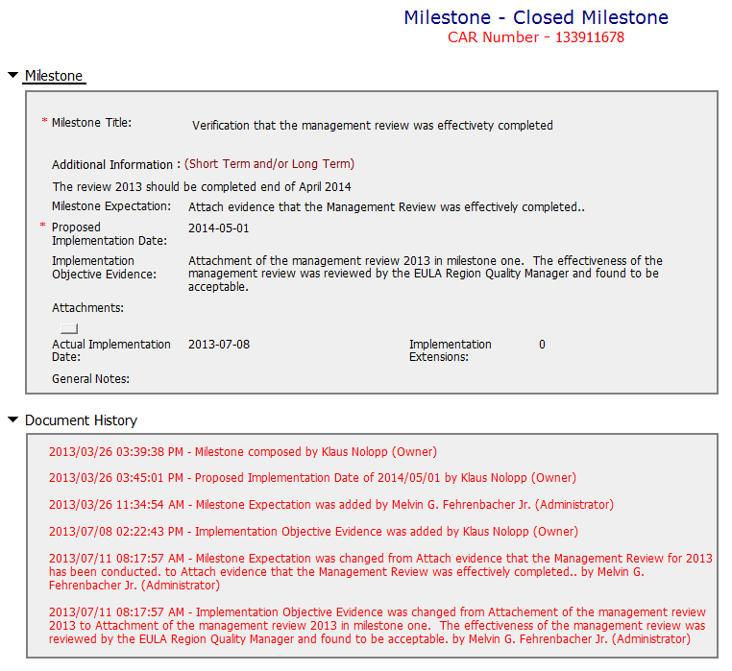
CAR# 133911678 (Milestones)
Although CAR owner self-verification is added at the last milestone, it doesn’t cover the corrective action for the failure conducting previous Management Review.
In fact, would the next round of Management Review be able to conducted on-time, it has not been addressed.
In addition, it is suggested that a statement should be provided by CAR Owner to indicate that “Recommendation for improvement” is now covered as input in the process of Management Review for Year 2011 and 2012 if it is really covered...
The evidence “Attachment of the management review 2013 in milestone one. The effectiveness of the management review was reviewed by the EULA Region Quality Manager (how, and evidence?) and found to be acceptable.” stated in the 2nd milestone is irrelevant while the Management Review for Year 2013 has not been conducted yet.
[Collaboration] (L, C L) – To be improved by working with CAR Owner to determine suitable milestones and set up their expectation.
[Competitiveness] (P) – To be improved by engaging with CAR Owner to complete milestone as per expectation.
[Integrity] (P) – To be improved of determination by declining the insufficient milestone.
Notes:
Milestones – have final milestone for owner’s verification of effectiveness; enough time is allowed for new records to be examined
Although CAR owner self-verification is added at the last milestone, it doesn’t cover the corrective action for the failure conducting previous Management Review.
In fact, would the next round of Management Review be able to conducted on-time, it has not been addressed.
It is suggested that the verification should focus on whether the updated process and/or next round of Management Review is in place to avoid recurrence of such nonconformity.
Milestones – completed per milestone expectations
It is acceptable as Containment Action for the supporting evidence covered in the 1st milestone, i.e. Management Review Report for Year 2011 and Year 2012 [Suggest to inviting a person could read German for verification…].
However, the evidence “Attachment of the management review 2013 in milestone one. The effectiveness of the management review was reviewed by the EULA Region Quality Manager and found to be acceptable.” stated in the 2nd milestone is irrelevant while the Management Review for Year 2013 has not been conducted yet. Not sure how CAR Administrator accepts it.
In addition, for 2nd milestone, it is suggested that a statement should be provided by CAR Owner to indicate that “Recommendation for improvement” is now covered as input in the process of Management Review for Year 2011 and 2012...

Slide 12
CAR# 133911678 (Verification)
Please be noted that this CAR hasn’t been closed yet. It is still under a state of “Closed Awaiting Verification”, hence, the field of “Verification Evidence” is still kept empty.
However, when both root cause identification and the related corrective action stated in 2nd milestone are questionable, the comment “The corrective action was effective” stated in the field of “CAR Effectiveness Indicator” shows too generic and lack of logical consideration… Not auditable.
[Collaboration] (C L) – To be improved by proactively working with CAR Owner to verify the effectiveness of the agreed CA Plan in the agreed time slots.
[Integrity] (P, T) – To be improved by providing reasonable and sufficient verification indicator.
Notes:
Verification – completed within 6 months of CAR closure or explanation provided; enough time is allowed for new records to be examined
Please be noted that this CAR hasn’t been closed yet. It is still under a state of “Closed Awaiting Verification”, hence, the field of “Verification Evidence” is still kept empty.
However, when both root cause identification and the related corrective action stated in 2nd milestone are questionable, the comment “The corrective action was effective” stated in the field of “CAR Effectiveness Indicator” shows too generic and lack of logical consideration…
If I were the CAR Administrator, will suggest the CAR Owner to reconsider the revisit of the current Management Review process and hence fill up the loophole resulting this nonconformance by adding one or two more milestones to illustrate and support the proper completion of corresponding efforts / activities. The timeline of last milestone for CAR Owner self-verification could be set right after completion of Management Review for Year 2013.
For the “General Notes”, shouldn’t it be an analysis field provided by CAR Owner instead of CAR Admin?

Slide 13
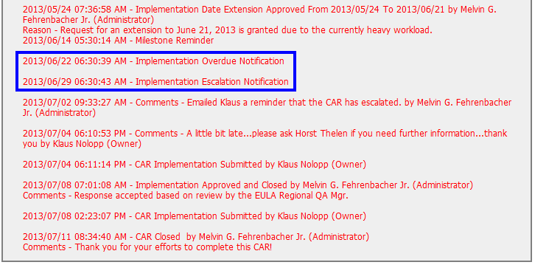
CAR# 133911678 (Extension)
The number of extensions is still meeting the requirement.
Other than this, suggest sending e-mail in advance to remind CAR Owner separately to avoid CAR overdue and/or escalation. Put the communication with CAR Owner into the CAR DB as evidence.
[Collaboration] (C L) – Good. Sending separated e-mail reminder to alert CAR Owner that the CAR has been escalation due to implementation overdue.
[Integrity] (C, T) – Good. No extension is over 30 days or more than 3 times.
Notes:
Extensions – within requirements (<30 days, 3 or less)
The number of extensions is still meeting the requirement.
Other than this, suggest sending e-mail in advance to remind CAR Owner separately to avoid CAR overdue and/or escalation. Put the communication with CAR Owner into the CAR DB as evidence.

Slide 14
Study for CAR# 123911950

Slide 15
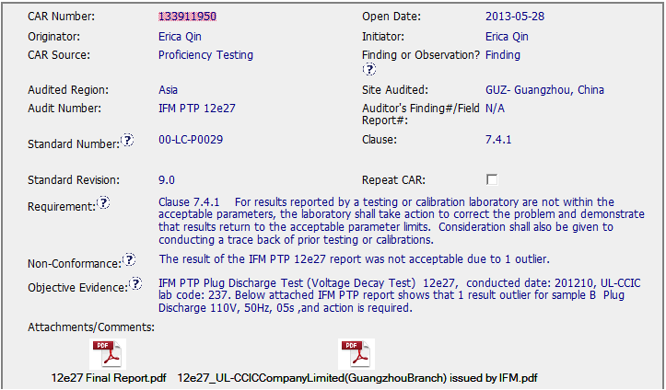
CAR# 133911950

Slide 16
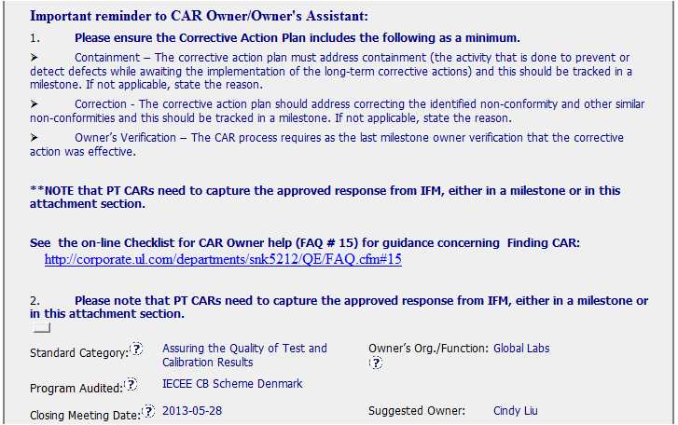
CAR# 133911950
Special Remind for IFM PT CAR
[Collaboration] (C L) Evidence of communication for other pertinent concerns – Yes

Slide 17
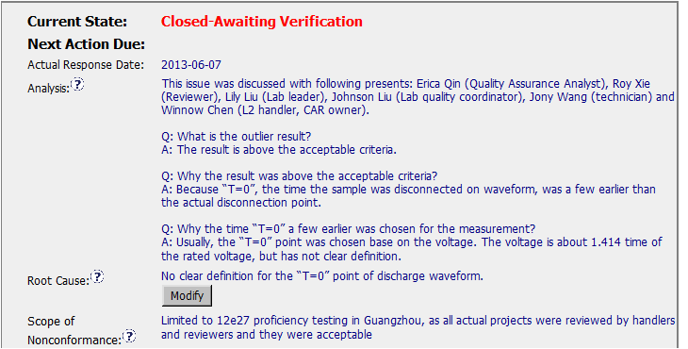
CAR# 133911950 – Analysis
Suggest to provide more clear statement to identify the correct definition and wrong definition applied in PTP
[Competitiveness] (C) Analysis shows clear path to root cause and scope; stakeholder identify – Yes
[Competitiveness] (C) Root cause statement is succinct, reasonable, complete – Yes

Slide 18
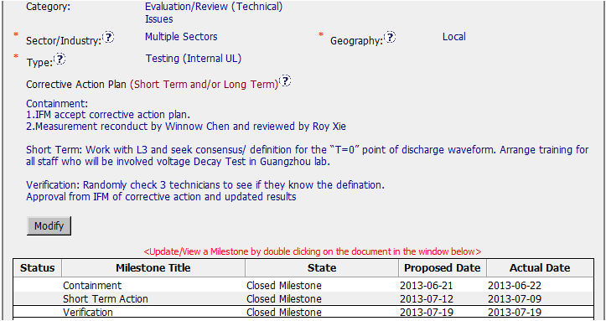
CAR# 133911950 – CAP
[Integrity] (T) Most appropriate ‘category’, ‘type’, ‘geography’ are selected. – Yes
[Competitiveness] (C) Corrective actions fix the objective evidence and other problems found; address entire root cause and scope – Yes
[Competitiveness] (C) Milestones address containment & owner’s verification – Yes

Slide 19
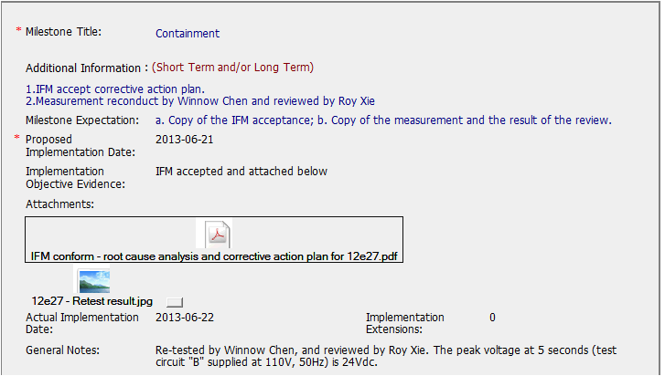
CAR# 133911950 – Containment Milestone
Clear identify the re-test results – 24V.
[Competitiveness] (C) completed per milestone expectations – No, see next page

Slide 20
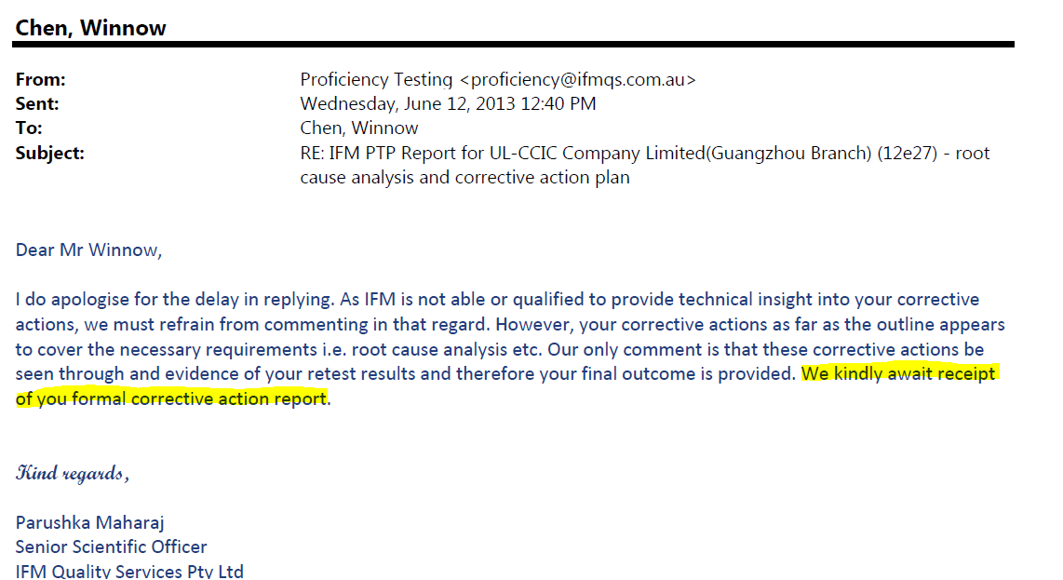
CAR# 133911950 – Containment Milestone
The evidence shows IFM await receipt of your formal CAR. NOT IFM accept it.

Slide 21
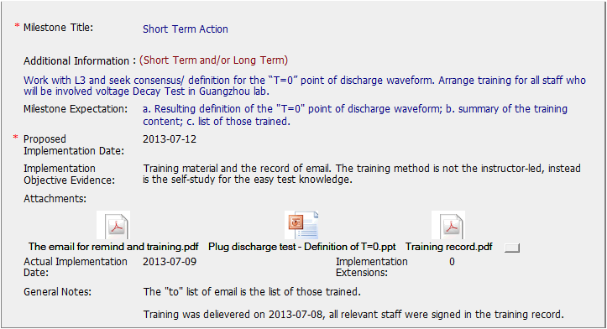
CAR# 133911950 – Short Term Action Milestone
Consider some absent staff, provide email to let them selfstudy.
[Competitiveness] (C) completed per milestone expectations – Yes

Slide 22
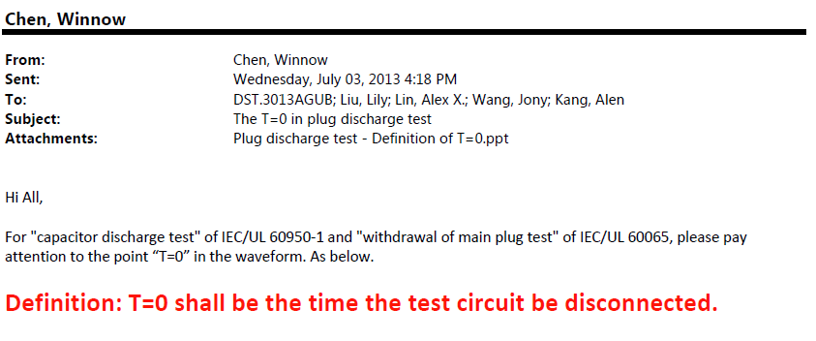
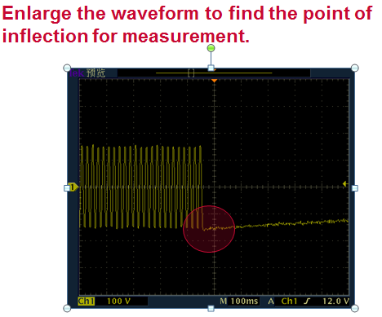
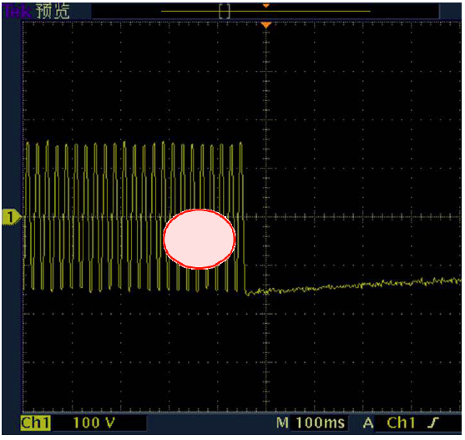
CAR# 133911950 – Short Term Action Milestone
Different diagram in classroom training ppt against email, Not consistent message for the “circle” in diagrams.

Slide 23
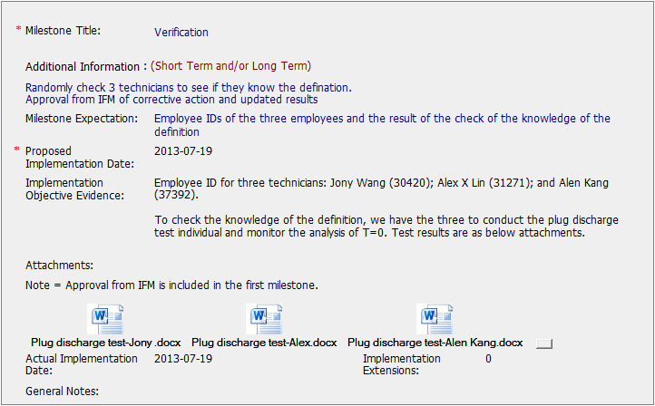
CAR# 133911950 – Verification
Each technician conduct the test to find T=0, 1s and 2s.
[Competitiveness] (C) completed per milestone expectations – Yes

Slide 24
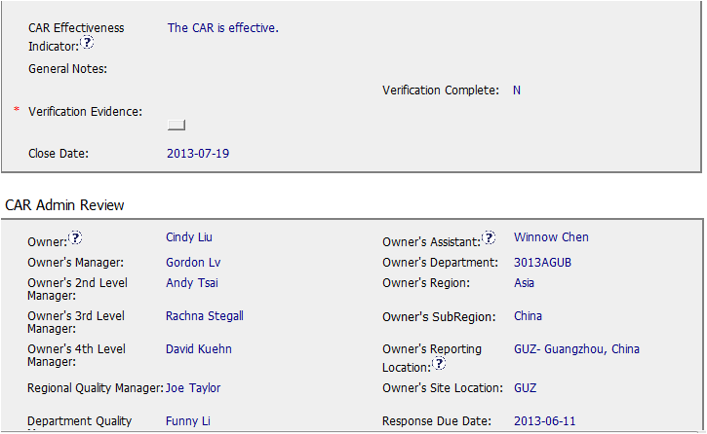
This should not be an indicator.
See FAQ 20
In addition, the CAR Effectiveness Indicator field should be completed with a brief description of what will show that the corrective action plan was successful.
[Competitiveness] (P) Verification per requirements. – No. No correct CAR Effectiveness Indicator.

Slide 25
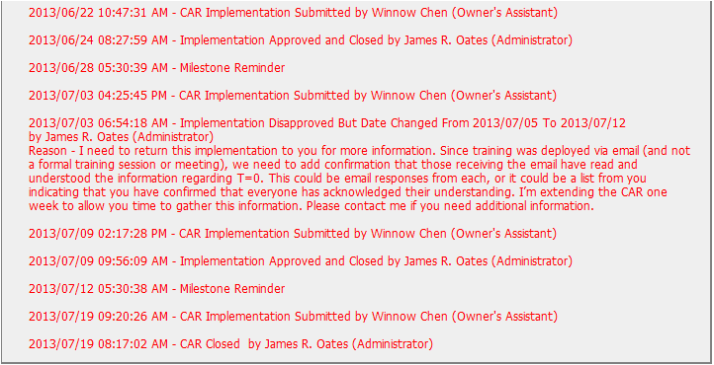
CAR# 133911950 – History
Work with Owner on implementation to cover all related staff in 2nd milestone.
[Integrity] (T) Acts on CARs within required timeframe. – Yes
[Collaboration] (C L) Evidence of communication for other pertinent concerns – Yes

Slide 26
Case Study
CAR 1 – Chris Nicastro Review – Chris Nicastro to discuss
CAR 2 – Julianne Heinzinger Review – Chris Nicastro to discuss
CAR 3 – Gunsimar Paintal Review – Dale Hendricks to discuss
CAR 4 – Dale Hendricks Review – Dale Hendricks to discuss
Team:
Dale Heindricks, Julianne Heinzinger, Chris Nicastro, Gunsimar Paintal

Slide 27
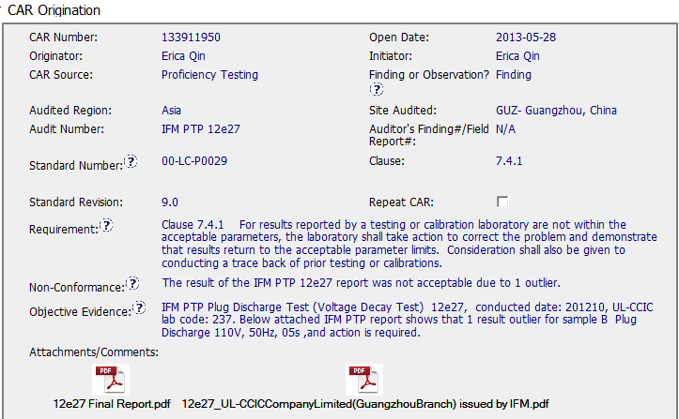
CAR – Sample 1 – CAR 133911950
Standard, Clause, and Requirement are clear
Non-Conformance is clear
Objective Evidence is detailed; it provides enough information to properly address, correct, and verify the Non-Conformance

Slide 28
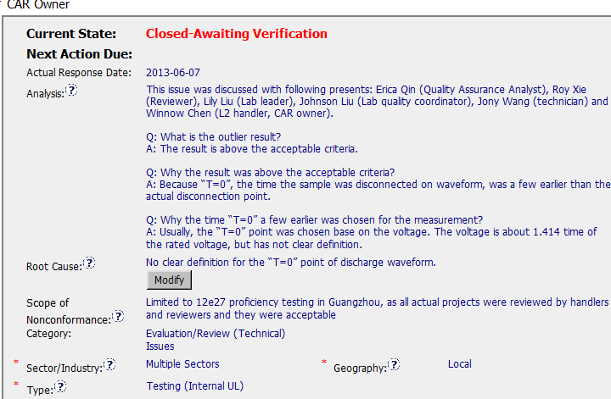
CAR – Sample 1 – CAR 133911950
Who worked on the CAR / Stakeholders - Good
Concern – Some of the answers (in the Analysis) are difficult to understand, possibly a language issue. Some editing to clarify may have helped.
Logical Drilling Down to find root cause - Good
The analysis leads logically to the Root Cause, which is clear, short, and concise.
Scope of NC is very clear, to show this is an isolated issue and help to show what is required for the Corrective Action Plan
Root Cause Category, Sector, Type, and Geography are accurate

Slide 29
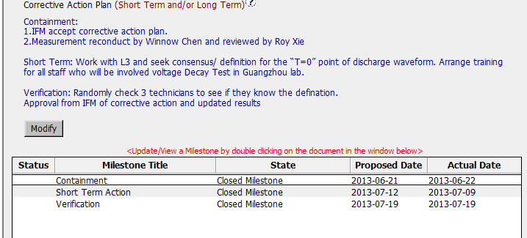
CAR – Sample 1 – CAR 133911950
Containment and Verification are addressed appropriately
Short Term Action addresses the understanding of the issue, and training
Milestones are discrete, there is no overlapping. They are clear and concise, therefore verification of each milestone is very clear.

Slide 30
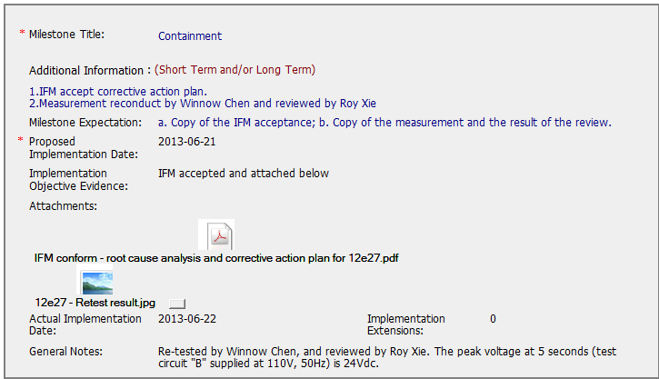
CAR – Sample 1 – CAR 133911950
Excellent Attachments, which clearly show the expectation in order to close/verify the milestone.

Slide 31
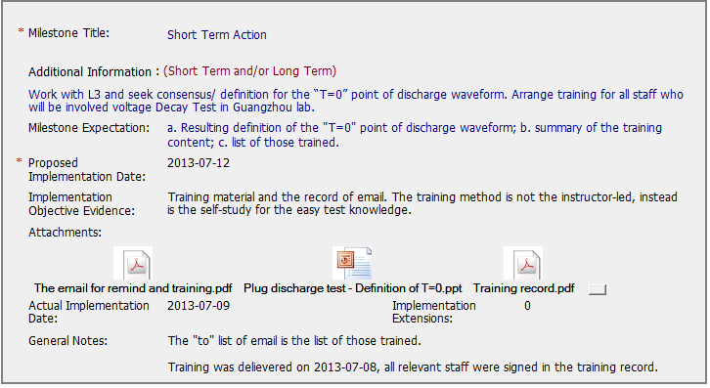
CAR – Sample 1 – CAR 133911950
Excellent Attachments, which clearly show the expectation in order to close/verify the milestone.

Slide 32
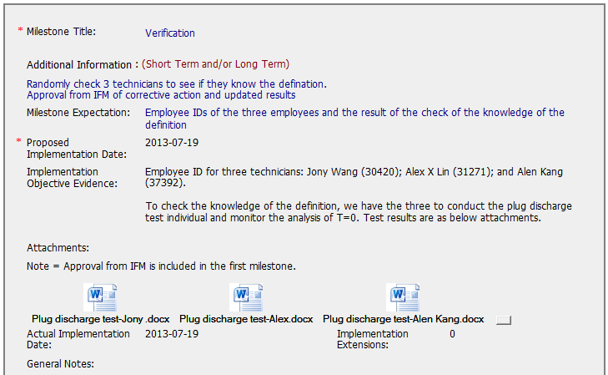
CAR – Sample 1 – CAR 133911950
Excellent Attachments, which clearly show the expectation in order to close/verify the milestone.

Slide 33
CAR – Sample 1 – CAR 133911950
Notes: Other than clarifying some sentences in the analysis, this CAR is excellent. There were not extension requested or overdue notices, and the Analysis, Root Cause, CAP, and milestones are all logical and very clear. This is a great CAR!

Slide 34
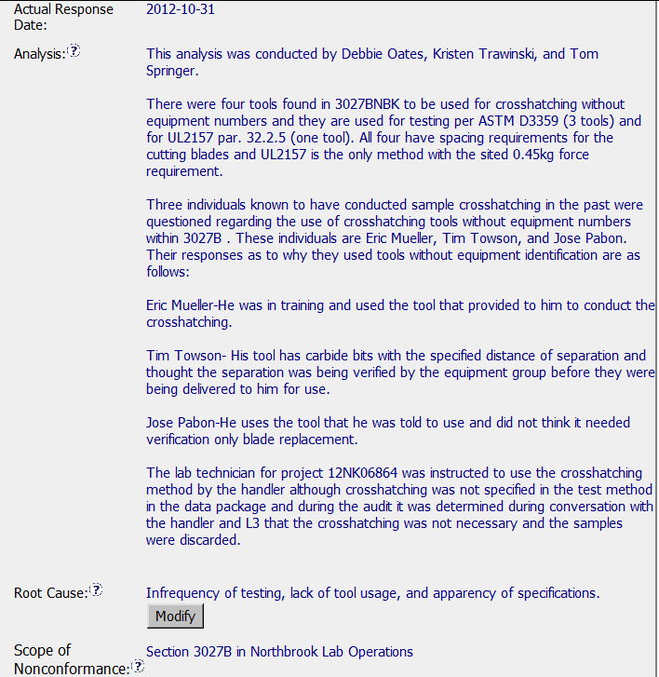
Exemplary CAR – Sample 2 – CAR 123911154
– What corrective actions are expected for this CAR?
Who conducted analysis is included
Clear that these tools were sought out and collected.
Who used the tools in the past was discovered and why they were used. This analysis gets to the real reason these were used, which is what we want in the analysis
Response Details
Root Cause is taken directly from the analysis. It is clear and concise.
Clear how big of issue exists.

Slide 35
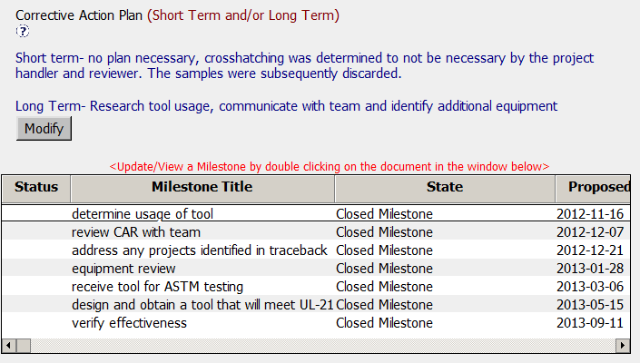
Exemplary CAR – Corrective Action Milestones
The milestones are each a separate event.
This is often preferable to trying to have one milestone cover too much.
As separate events, it keeps it precise as to what is to be accomplished in each milestone.
Containment Addressed
Corrective Action & Milestones
Milestones are all appropriate, they cover how the tool was used, a review with the team to explain the CAR and obtain input and suggestions, determine if a traceback is required, etc.

Slide 36
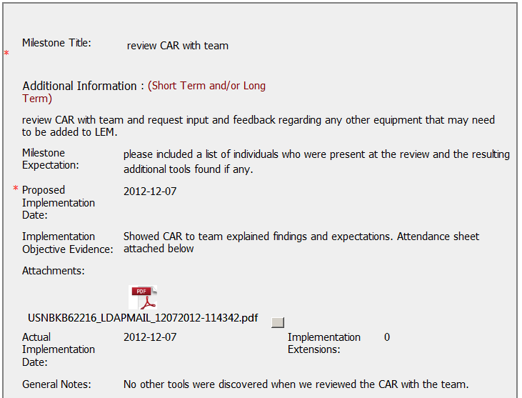
Exemplary CAR – Milestones in Action
This milestone is part of the containment exercise because they need to find out if there are any other tools.
The CAR was reviewed so the team could understand equipment requirements.
An attendance sheet is provided.
Select Milestones

Slide 37
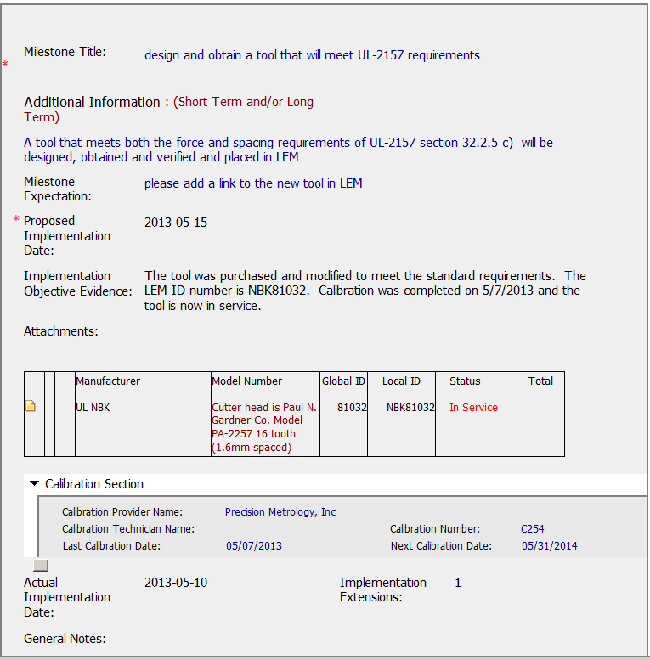
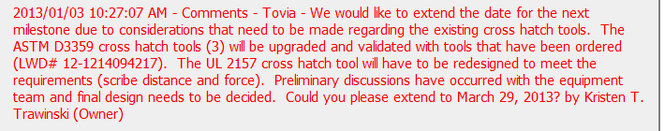
Exemplary CAR – Milestones in Action
This milestone includes evidence that the proper tool was obtained and added into the LEM system.
By ensuring it is in the LEM system, it will be included in calibration.
Select Milestones
Request for extension appropriate. Shows action has been taken and legitimately why more time is required.

Slide 38
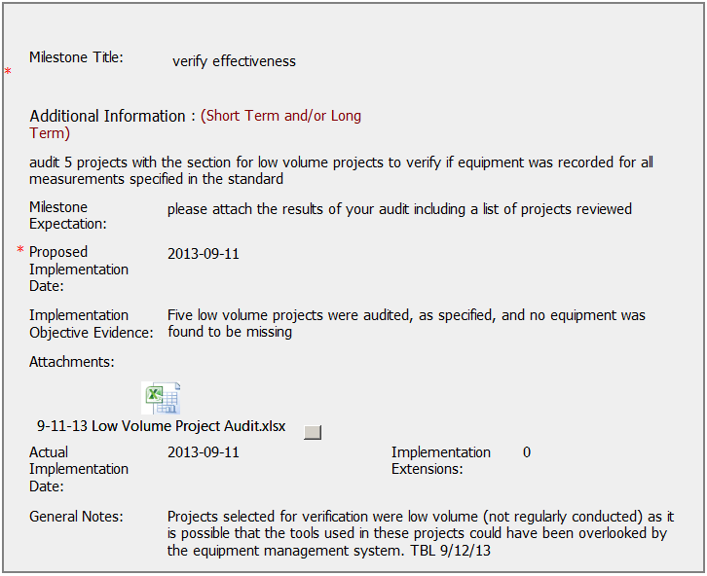
Exemplary CAR – Verification Milestone
Important milestone because this is where the owner can see if the actions implemented were effective.
A spreadsheet is attached which provides a list of projects and shows the verification was conducted.
Owner Verification
CAR Admin provided additional information for clarification

Slide 39
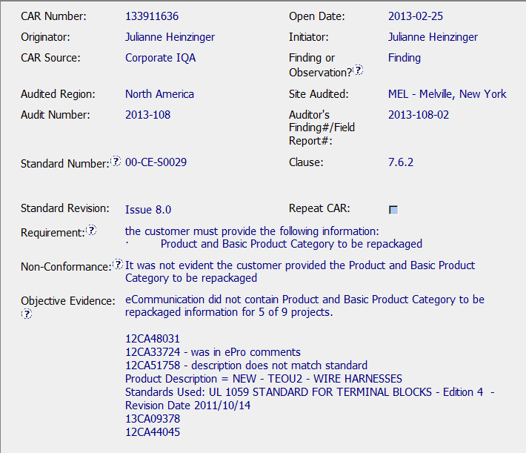
CAR – Sample 3
CAR Number: 133911636
Key elements of the CAR process complied with by correct references to the SOP, Issue no., clause etc.
2. Objective evidence has the necessary detail with Projects reviewed.

Slide 40
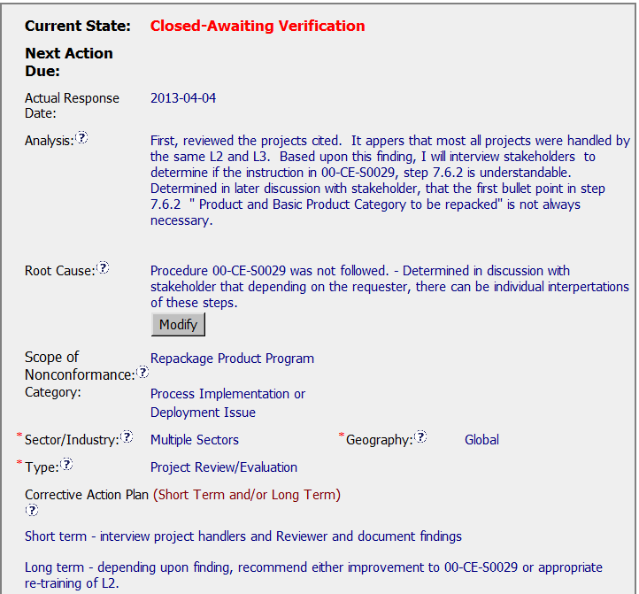
CAR Sample 3
CAR Number 133911636
ANALYSIS
a part of the Analysis is actually in the Containment milestone. If the analysis would have captured this exercise to determine the benefit to revise if any and/or how many open projects are in fact in ePro, the Containment step would not have been necessary with a note “Containment not required since no open projects or only one open project and in compliance”. This being a part of the scope analysis.
ROOT CAUSE
Is too long, the 2nd sentence is really part of the analysis

Slide 41
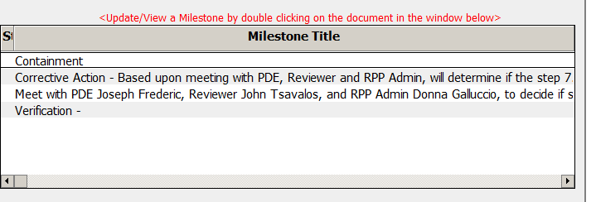

CAR – Sample 3
CAR Number: 133911636
Milestone Titles ( for milestone 2 & 3) should be short and all additional information captured in the section on Additional Information.
Milestones have a lot of information, overall a good thing but at times one gets lost in the weeds.
Overall, this being the RPP program, given what was accomplished was the best under the circumstances.

Slide 42

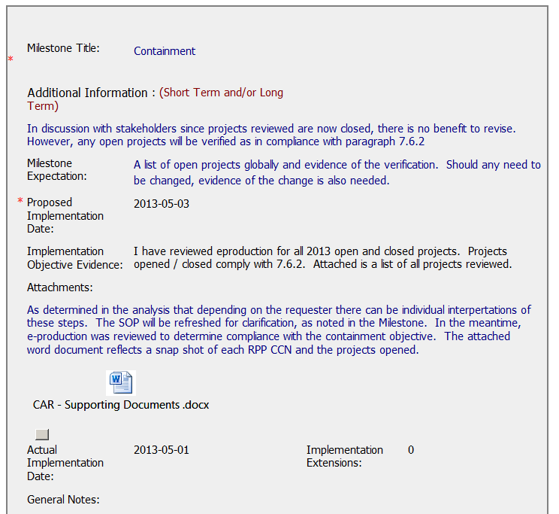
CAR – Sample 3
CAR Number: 133911636
Milestone 1: Containment
Created on April 4, 2013 and implementation objective evidence added on May 1, 2013.
It appears this was an afterthought and added after the “Milestone 2 on Corrective Action” since the CAR document history does not track comments to this effect. May have been verbal or via e-mail between the CAR Owner & CAR Admin.

Slide 43

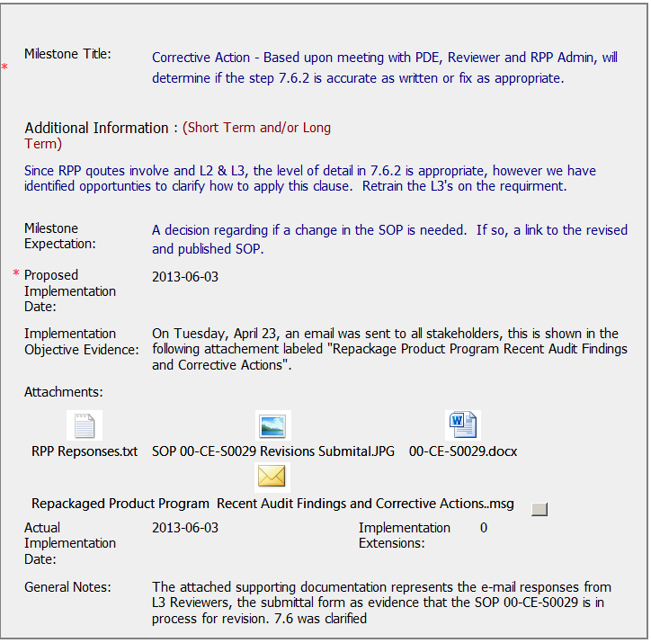
CAR – Sample 3
CAR Number: 133911636
Milestone 2: Corrective Action - Based upon meeting with PDE…
Created on March 25, 2013 and implementation objective evidence added on May 1, 2013.
Milestone expectation - A decision regarding if a change in the SOP is needed. If so, a link to the revised and published SOP.
Milestone accepted on June 11, 2013 while the SOP Approval Status was “pending”. This milestone should have been accepted only once the link to the revised and published SOP was available. The actual date of publication of the SOP was July 12, 2013, one month after the milestone was approved and closed.

Slide 44
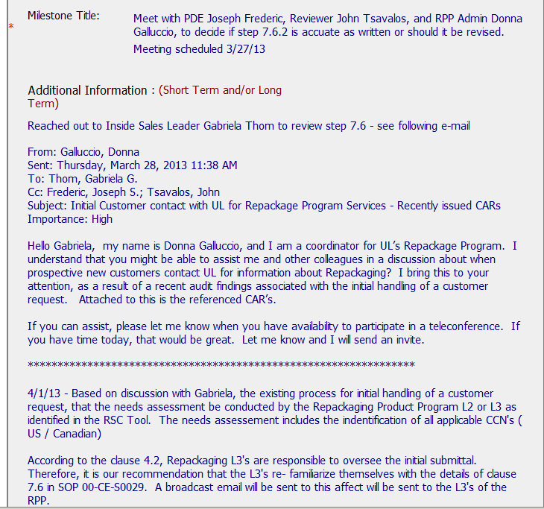
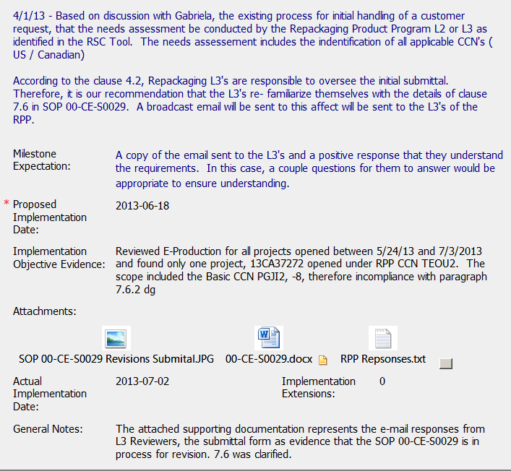
CAR – Sample 3
CAR Number: 133911636
Milestone 3: Meet with PDE Joseph Frederic…..
Milestone expectation – 2nd sentence “In this case, a couple questions for them to answer would be appropriate to ensure understanding”.
This essentially should be determined by the CAR owner as part of the refresh and/or the requirements in the SOP, be it a couple or more questions. By suggesting a couple, are we giving the impression of a minimum criteria to the CAR owner based on which the milestone will be accepted as implemented.
Evidence of Projects between May 24, 2013 to July 3, 2013 not provided in the milestone. There apparently was only one project 13CA37272, however, a listing of all projects that were checked should have been attached as evidence of the effort as well as showing the date range selected.

Slide 45

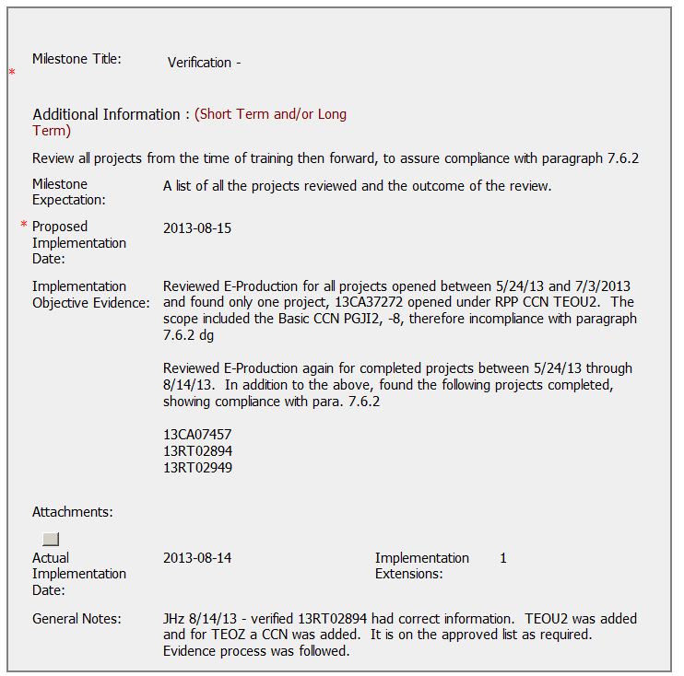
CAR – Sample 3
CAR Number: 133911636
Milestone 4: Verification
Milestone expectation – A list of all the projects reviewed and the outcome of the review.
The expectation should be specific. Here as a suggestion, rather than state all projects, better would have been to state a date range or an ‘x’ no. of projects. Knowing that RPP has a limited scope and no. of CCN’s, as such we do not expect a large no. of projects. However, there needs to be a reasonable no. / length of time to determine effectiveness of the corrective actions.

Slide 46
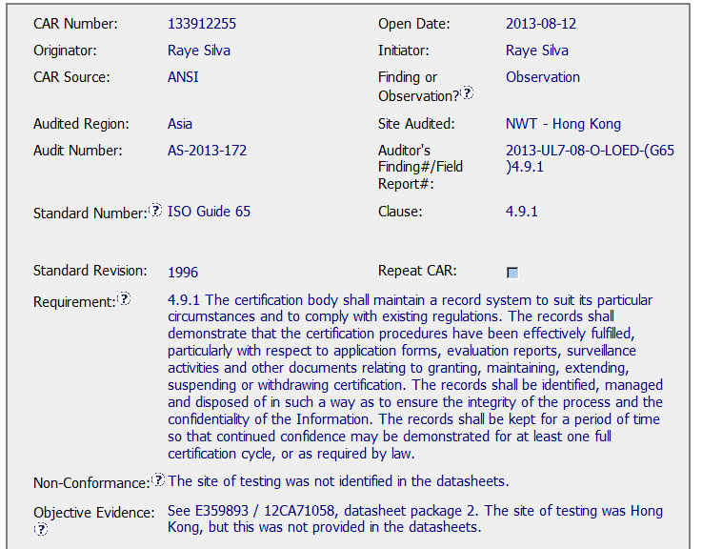
CAR – Sample 4 – CAR 133912255
Closing Meeting Date was
2013-05-22
CAR was not entered until
2013-08-12

Slide 47
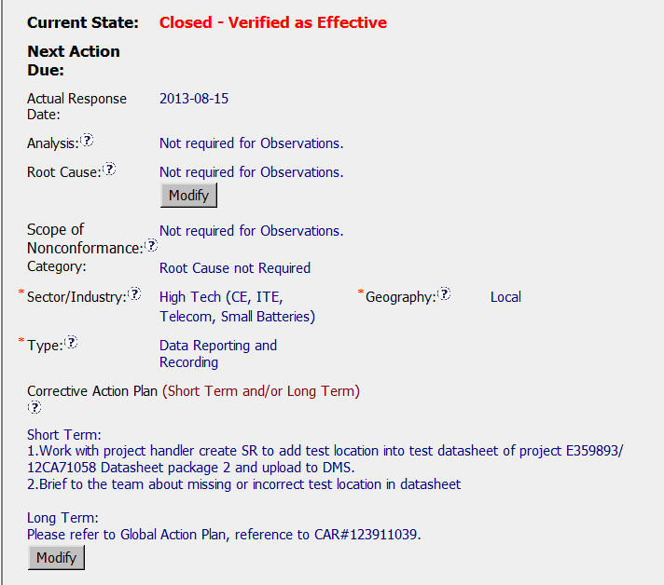
CAR – Sample 4 – CAR 133912255
CAR Process Website FAQ 15 suggests use of the verbiage “Not Applicable”
Sector / Industry for CCN – ATNZ is actually – Appliances / HVAC

Slide 48

CAR – Sample 4 – CAR 133912255
Good response time from owner, 3 days
Good verification statement

Slide 49
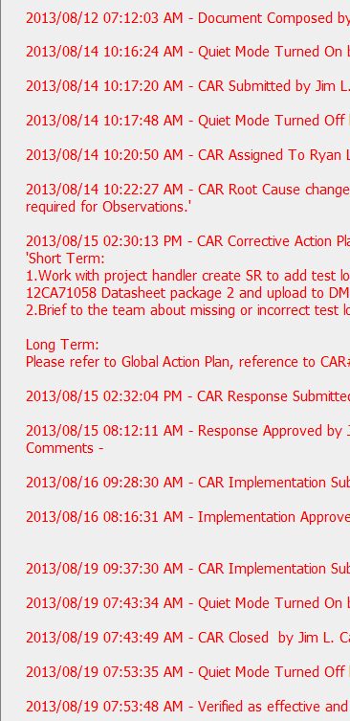
CAR – Sample 4 – CAR 133912255
Not clear on the frequent use of “Quiet Mode,” is it necessary?

Slide 50

CAR Review
Sept 27, 2013
Mark Lavine, Mel Fehrenbacher

Slide 51
CAR 133911678
Well written finding, clear, referenced requirement.
Analysis is thin
Second milestone should have had “Response accepted based on review by the EULA Regional QA Mgr”
Isolated instance? If so what evidence to demonstrate this? Additional samples.
Is there opportunity to prevent recurrence even though this is unusual situation?
Competitiveness requires speed, change. It challenges us to maintain integrity in a competitive environment

Slide 52
CAR 133911636
Good sample size in finding
Good use of attachments
Analysis good, but could have been more robust, for example, if the Product and Basic Product Category, is not always needed, why was this not mentioned in the SOP?
Containment and verification included
Action taken to prevent recurrence- procedure changes- good.
Good collaboration between PDE and CAS

Slide 53

CAR 133911831-OFI/Obs
Generally good level of attention for OFI
Provided training and revised datasheet- good.
Overall very good handling of Observation.
Proper record-keeping helps maintain integrity

Slide 54
“Exemplary” CAR 133911497
Thorough containment (“traceback”)
Immediate action addresses ongoing projects
Use of “Why” technique in analysis
Action was timely and appropriate
Could have been additional sampling to confirm issue was “local”
Could there have been some mistake proofing to prevent this from happening again?
Did imbalance between “competitiveness” and “integrity” help lead to this non-conformance?

Slide 55
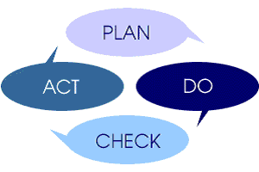
Questions/Discussion

